Slide 1
Measuring Similarity/Dissimilarity

Slide 2
Similarity/Dissimilarity
Briefly outline how to compute the dissimilarity between objects described by the following types of variables:
Numerical (interval-scaled) variables

Slide 3
Similarity/Dissimilarity
Briefly outline how to compute the dissimilarity between objects described by the following types of variables:
Numerical (interval-scaled) variables
Use Euclidean distance or Manhattan distance. Euclidean distance is defined as:
The Manhattan distance is defined as:

Slide 4
A = (2, 4)
B = (1, 3)
Euclidean distance = math.sqrt(pow(2-1, 2) + pow(4-3, 2))
A = (2, 7, 5)
B = (4, 8, 9)
ed = math.sqrt(pow(2-4, 2) + pow(7-8, 2) + pow(5-9, 2))
Euclidean distance is the direct and straight line distance.
Whereas:
Manhattan distance is indirect and calculated along x and y axis.

Slide 5
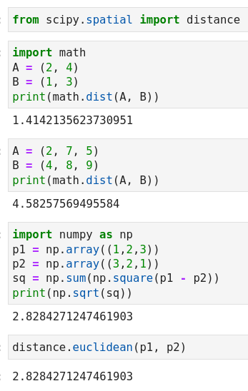
Euclidean Distance

Slide 6
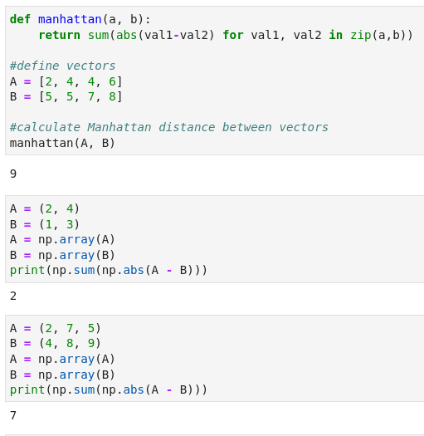
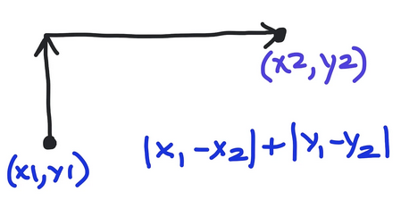
Manhattan Distance

Slide 7
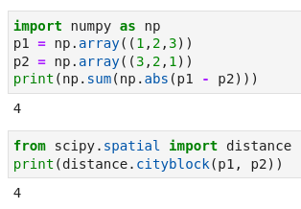

Slide 8
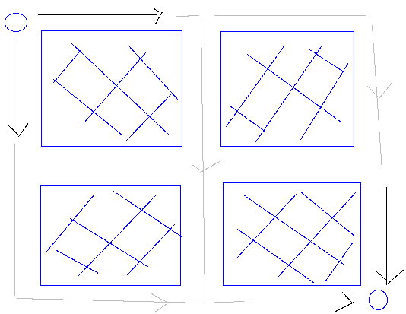
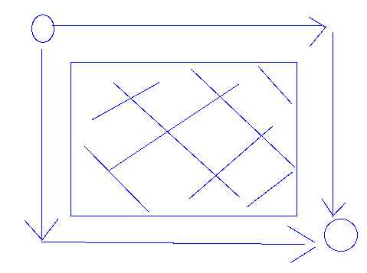
Manhattan Distance
Manhattan Distance is inspired from a traveler going from one point to another in the city of Manhattan.

Slide 9
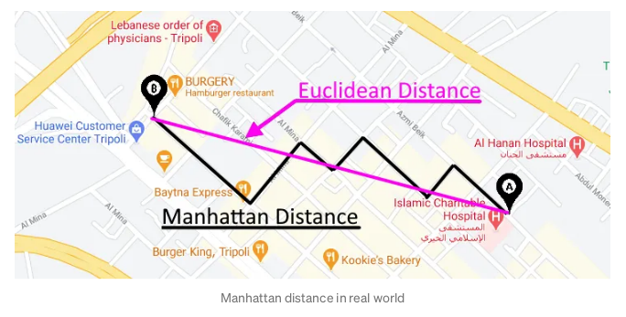
Euclidean distance: Straight line distance between two points.
Manhattan distance: is cityblock distance that is you would go from place to place in car.

Slide 10
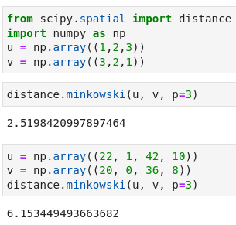
Minkowski Distance
Given two objects represented by the tuples (22, 1, 42, 10) and (20, 0, 36, 8):
Compute the Minkowski distance between the two objects, using p = 3.
In plain English: kth root of sum of kth powers of absolute value of differences.
For manhattan distance, p = 1 in Minkowski dist.
For euclidean distance, p = 2 in Minkowski dist.
Manhattan and Euclidean distances are special cases of Minkowski.

Slide 11
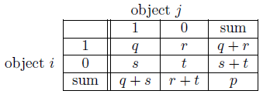
Similarity/Dissimilarity
Briefly outline how to compute the dissimilarity between objects described by:
Asymmetric binary variables
If all binary attributes have the same weight then they are symmetric. Let’s say we have the contingency table:
If the binary attributes are asymmetric, Jaccard coefficient is often used:
For cell (i=1, j=1) representing #(object I = 1 and object J = 1):
J = q / (q + r + s)
J = # elements in intersection / # elements in the union
Jaccard similarity (aka coefficient or score) ranges from 0 to 1.
Jaccard dissimilarity (aka distance) = 1 – Jaccard Similarity

Slide 12
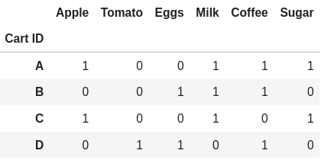
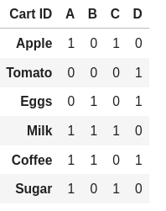

Slide 13
The reason why ‘t’ is not considered in Jaccard coeff. Is because, while taking an example of shopping cart, it would not make same sense to count the number of times that were missing from both the cart I and J. If we count the number of items that were missing in both carts, it would increase the similarity.
If it is given the attributes are binary and assymmetric, t is not counted. If it is symmetric, then formula for J may include ‘t’ in the numerator and denominator:
J = (q + t) / (q + r + s + t)

Slide 14
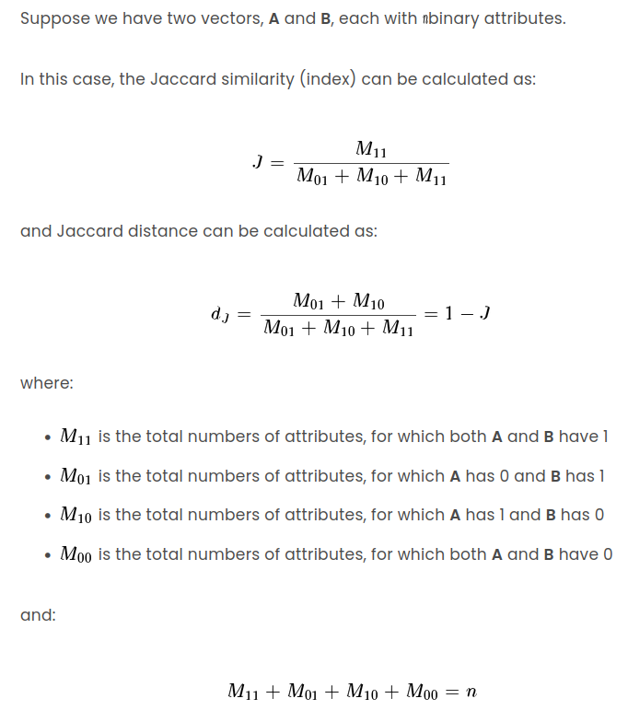

Slide 15
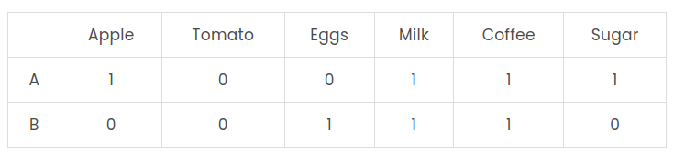

Slide 16
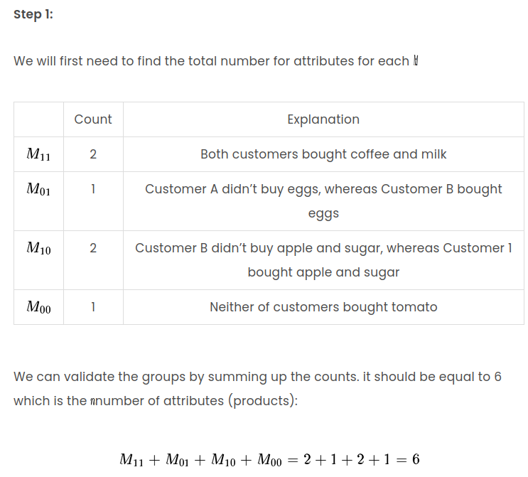

Slide 17
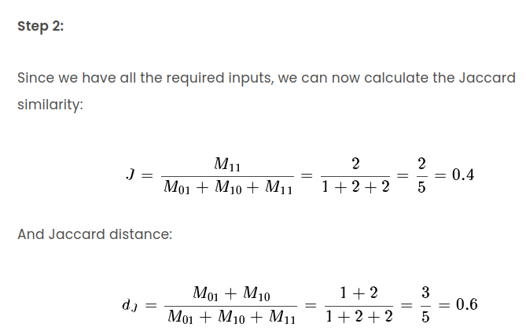

Slide 18

Similarity/Dissimilarity
Briefly outline how to compute the dissimilarity between objects described by the following types of variables:
Categorical variables
A categorical variable is a generalization of the binary variable in that it can take on more than two states.
The dissimilarity between two objects i and j can be computed as:
where m is the number of matches (i.e., the number of variables for which i and j are in the same state), and p is the total number of variables.

Slide 19

Similarity/Dissimilarity
Between text type of data:
This is equal to dot-product of the corresponding features divided by the magnitude. Geometrically, it is equal to the cosine of angle between two lines.

Slide 20
Cosine similarity is commonly seen in text data.
V | D1 | D2 | D3 | D4 | D5 | D6 | D7 | D8 | D9 | D10
A | 1 | 1 | 0 | 1 | 1 | 0 | 0 | 1 | 1 | 0
B | 1 | 0 | 1 | 0 | 1 | 1 | 1 | 0 | 0 | 0
C | 0 | 1 | 0 | 0 | 1 | 1 | 0 | 1 | 0 | 1
D | 1 | 0 | 0 | 0 | 0 | 1 | 0 | 1 | 0 | 0
E | 1 | 0 | 1 | 0 | 1 | 1 | 0 | 0 | 0 | 0
Which two out of these vectors are closest?
And, which two out of these vectors are farthest?

Slide 21
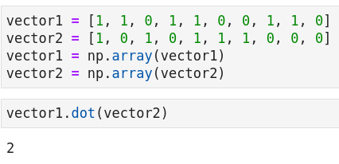
A | 1 | 1 | 0 | 1 | 1 | 0 | 0 | 1 | 1 | 0
B | 1 | 0 | 1 | 0 | 1 | 1 | 1 | 0 | 0 | 0
A.B | 1 | 0 | 0 | 0 | 1 | 0 | 0 | 0 | 0 | 0
There are two ones so sum()
= 1 + 0 + 0 + 0 + 1 + 0 + 0 + 0 + 0 + 0
= 2

Slide 22
A | 1 | 1 | 0 | 1 | 1 | 0 | 0 | 1 | 1 | 0
B | 1 | 0 | 1 | 0 | 1 | 1 | 1 | 0 | 0 | 0
|A| = math.sqrt(1**2 + 1**2 + 0 + 1**2 + 1**2 + 0 + 0 + 1**2 + 1**2 + 0)
= 2.449489742783178
|B| = math.sqrt(1**2 + 0 + 1 + 0 + 1 + 1 + 1 + 0 + 0 + 0)
= 2.23606797749979

Slide 23
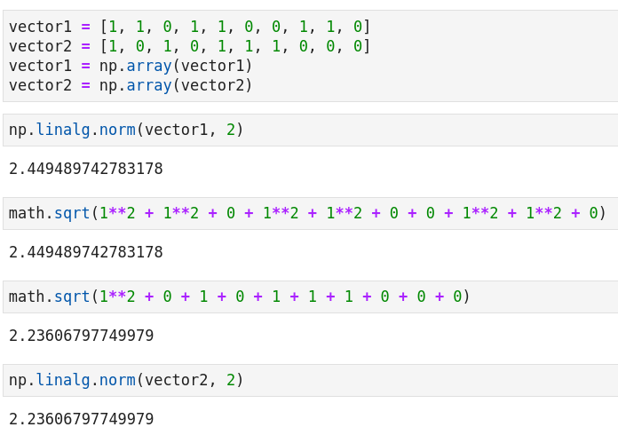

Slide 24
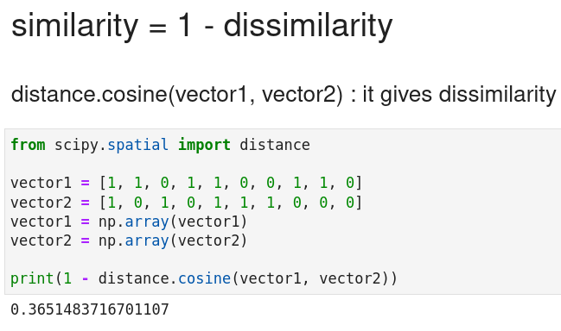
A | 1 | 1 | 0 | 1 | 1 | 0 | 0 | 1 | 1 | 0
B | 1 | 0 | 1 | 0 | 1 | 1 | 1 | 0 | 0 | 0
A.B | 1 | 0 | 0 | 0 | 1 | 0 | 0 | 0 | 0 | 0
Cos similarity (A, B) --> cos(theta) = A.B / |A|.|B|
Cosine similarity = 2 / ( 2.449 * 2.236 )
= 0.3652324960500105

Slide 25
Cosine Similarity
A = (4, 4)
B = (4, 0)
(4,4)
(0,0)
(4,0)
Cosine similarity between A and B is: cos(theta)
Note: It is very easy to visualize it in 2D.
Formula wise: Cosine similarity = A.B / |A| * |B|
This formula has come after rearranging the dot product formula:
A.B = |A| * |B| * cos(theta)

Slide 26
Cosine Similarity
Find cosine similarity between the following two sentences:
IIT Delhi course on data analytics IIT
IIT Delhi course on data analytics
Term: tf for d1, tf for d2
d1.d2 = 2.1 + 1.1 + 1.1 + 1.1 + 1.1 + 1.1 = 7
|d1| = sqrt(2^2 + 1^2 + 1^2 + 1^2 + 1^2 + 1^2) = sqrt(9)
|d2| = sqrt(1^2 + 1^2 + 1^2 + 1^2 + 1^2 + 1^2) = sqrt(6)
Cosine similarity = d1.d2 / |d1| * |d2| = 7 / sqrt(9*6) = 0.93
IIT | 2 | 1
Delhi | 1 | 1
Course | 1 | 1
On | 1 | 1
Data | 1 | 1
Analytics | 1 | 1

Slide 27
Cosine Similarity
Sent 1: I bought a new car today.
Sent 2: I already have a new car.
Step 1: Create vectors.
 | Vector 1 | Vector 2 | Product of components
I | 1 | 1 | 1
bought | 1 | 0 | 0
a | 1 | 1 | 1
new | 1 | 1 | 1
car | 1 | 1 | 1
today | 1 | 0 | 0
already | 0 | 1 | 0
have | 0 | 1 | 0

Slide 28
Cosine Similarity
V1 = 1,1,1,1,1,1,0,0
V2 = 1,0,1,1,1,0,1,1
v1.v2 = 1 + 0 + 1 + 1 + 1 + 0 + 0 + 0 = 4
|v1| = math.sqrt(1**2 + 1**2 + 1**2 + 1**2 + 1**2 + 1**2 + 0 + 0) = 2.45
|v2| = math.sqrt(1**2 + 0 + 1**2 + 1**2 + 1**2 + 0 + 1**2 + 1**2) = 2.45
Cosine sim = 4 / (2.45 * 2.45)
= 0.66

Slide 29
Cosine Similarity
Cosine Similarity: It is a bag-of-words based model i.e., order of words does not matter.
Sent1: I bought a new car today.
Sent2: I haven’t bought a new car today.
Step 1: Creating vectors
Cosine similarity is based on whether same words have been used in two sentences.
“How similar are two sentences in terms of the words (irrespective of their meaning) used in them?”

Slide 30
Cosine Similarity
Find cosine similarity between the following two sentences:
Brand new course on data analytics
Test-1 is scheduled later this month
Cosine similarity = 0.0

Slide 31
In Code Following Steps Would Be Followed To Find The Cosine Similarity Between Two Sentences
1. Load the libraries like Scikit Learn.
Projects might include other libraries like Pandas, NumPy, NLTK (Natural Language Toolkit).
2. Load the data (i.e. your two sentences)
3. Convert them into vector form using CountVectorizer.
Note: there are some other ways also to convert a sentence into vector, but we want to keep it simple for first class.
4. Next, you can use this method: sklearn.metrics.pairwise.cosine_similarity() to find the cosine similarity.
Note: These are high level steps. You can find a lot of similarity/dissimilarity measures following these steps after some minor modifications like changing Scikit Learn with SciPy, etc.

Slide 32
Thank You!

